Slide 1

PEOPLE FLEXIBLY USE DIFFERENT EXPLORATION STRATEGIES ACROSS LEARNING ENVIRONMENTS
T.D Ferguson, A. Fyshe, A. White, O.E. Krigolson

Slide 2

How do we explore?
Exploration – when we choose options that aren’t the highest value
There are number of ways to operationalize exploration strategies, using computational models
Explore?

Slide 3
How do we explore?
Reinforcement Learning Based
Prominent one: Random vs Directed exploration (Wilson et al., 2014)
Hybrid: combine both random and directed (Daw et al., 2006)
Random
Directed
50%
50%
100%
0%
Higher Uncertainty

Slide 4
How do we explore?
Other approaches
Bayesian: Thompson Sampling using uncertainty (Speekenbrink & Konstantinidis, 2015)
Heuristics: Win-Stay, Lose-Shift (e.g., Wu et al., 2018)

Slide 5
Are we consistent in how we explore?
Evidence humans switch how they explore depending on task demands
Risky/safe (Schulz et al., 2018); spatial/non-spatial (Wu et al., 2020)
But what about environmental volatility?
Different forms of learning needed in volatile vs stable tasks (e.g., Dayan, 2013; Costa et al., 2016)

Slide 6
Generalization
Do aspects of exploratory behaviour generalize across contexts?
For example, are people consistent in how often they explore?
Switch rate is more consistent than choice rate across Iowa Gambling Task sessions (Yechiam, 2020)

Slide 7
Research Questions
Do people use different exploration strategies when volatility changes across tasks?
Is there any relationship between exploration rate across tasks?
Ferguson et al., accepted

Slide 8
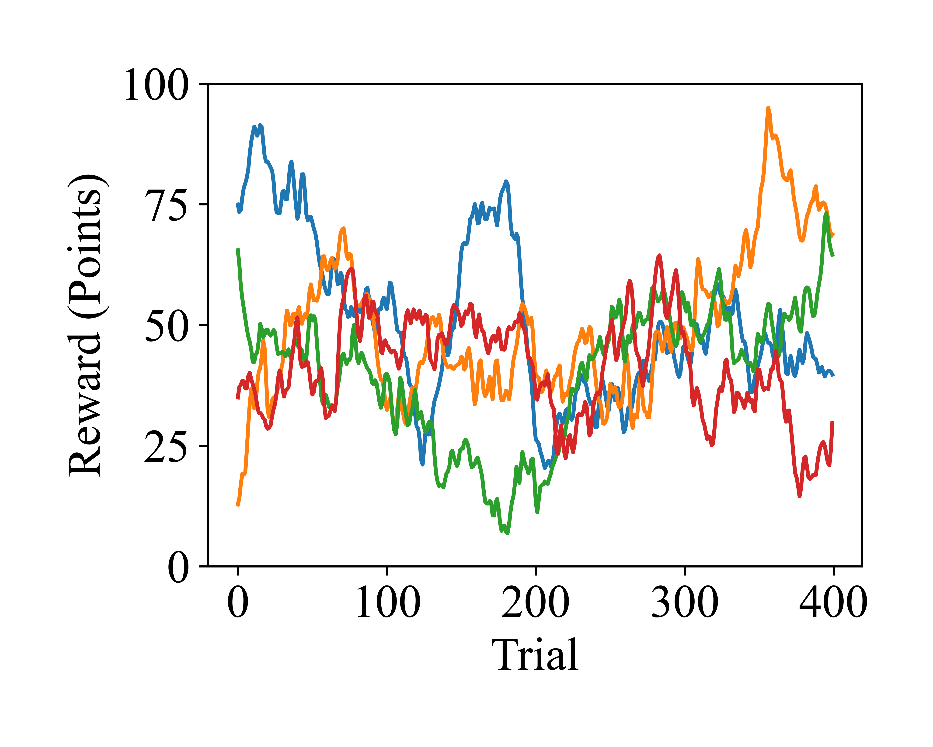
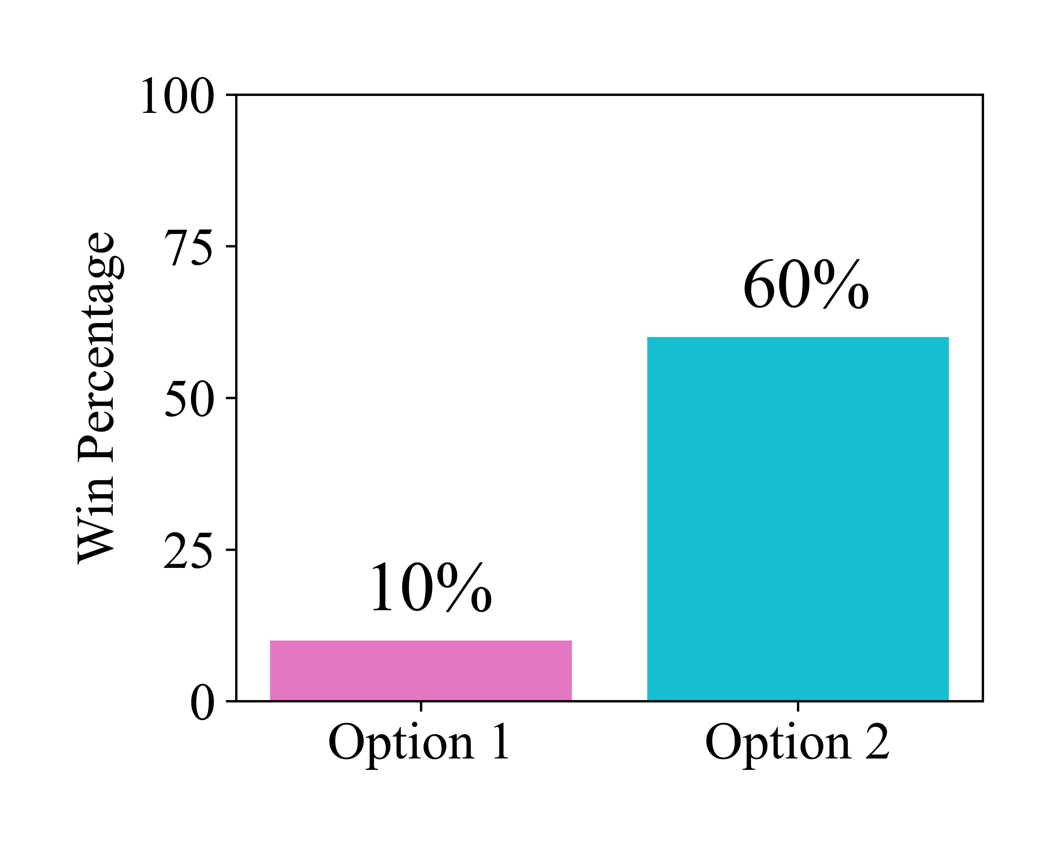
Two Learning Tasks
Volatile (400 trials; Daw et al., 2006)
Stable (6 blocks of 20 trials; Williams et al., 2021)
+
+
Choices Appear
Choices Appear
+
52
Selection
Selection
Win
Feedback
Feedback
Ferguson et al., accepted
n = 30

Slide 9
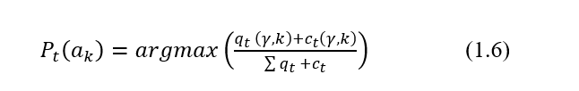
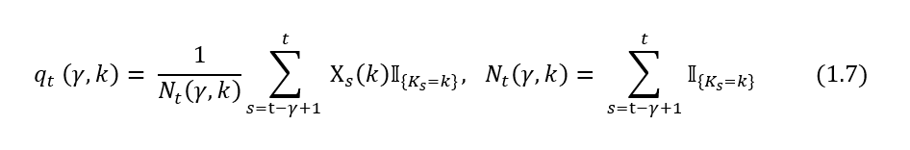
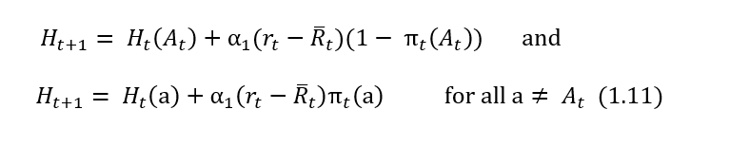
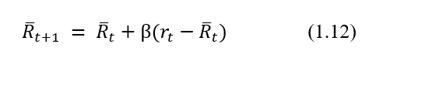
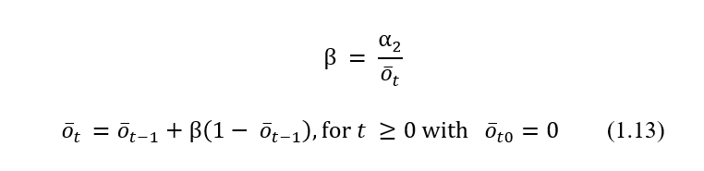
Model Comparison

Slide 10
Model Comparison
Reinforcement learning (value based)
Random – Softmax
Directed – Upper Confidence Bound
Hybrid – Combined Softmax and Upper Confidence Bound
Bayesian Probability matching: Thompson Sampling w/ Kalman Filter
Heuristic – Win-Stay, Lose-Shift
Ferguson et al., accepted

Slide 11
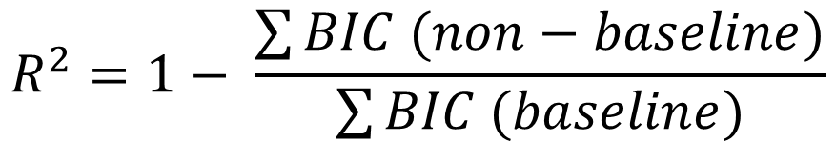
Model Fitting
Fit each model per task per participant using choice data (one-step ahead; Ahn et al., 2008)
Calculate pseudo R² value (e.g., Ludwig et al., 2022)
$$R^{2}=1− \frac{\sum{BIC (non−baseline)}}{\sum{BIC (baseline)}}$$
Model that didn’t learn
Ferguson et al., accepted

Slide 12
Modelling Performance
Important: best fit models don’t always replicate behaviour (Palminteri et al., 2017; Wilson & Collins, 2019)
Simulate participant behaviour by running the models through the tasks
Classified trials as explorations using the models
Note: WSLS – exploration is win-shift or lose-stay
Ferguson et al., accepted

Slide 13
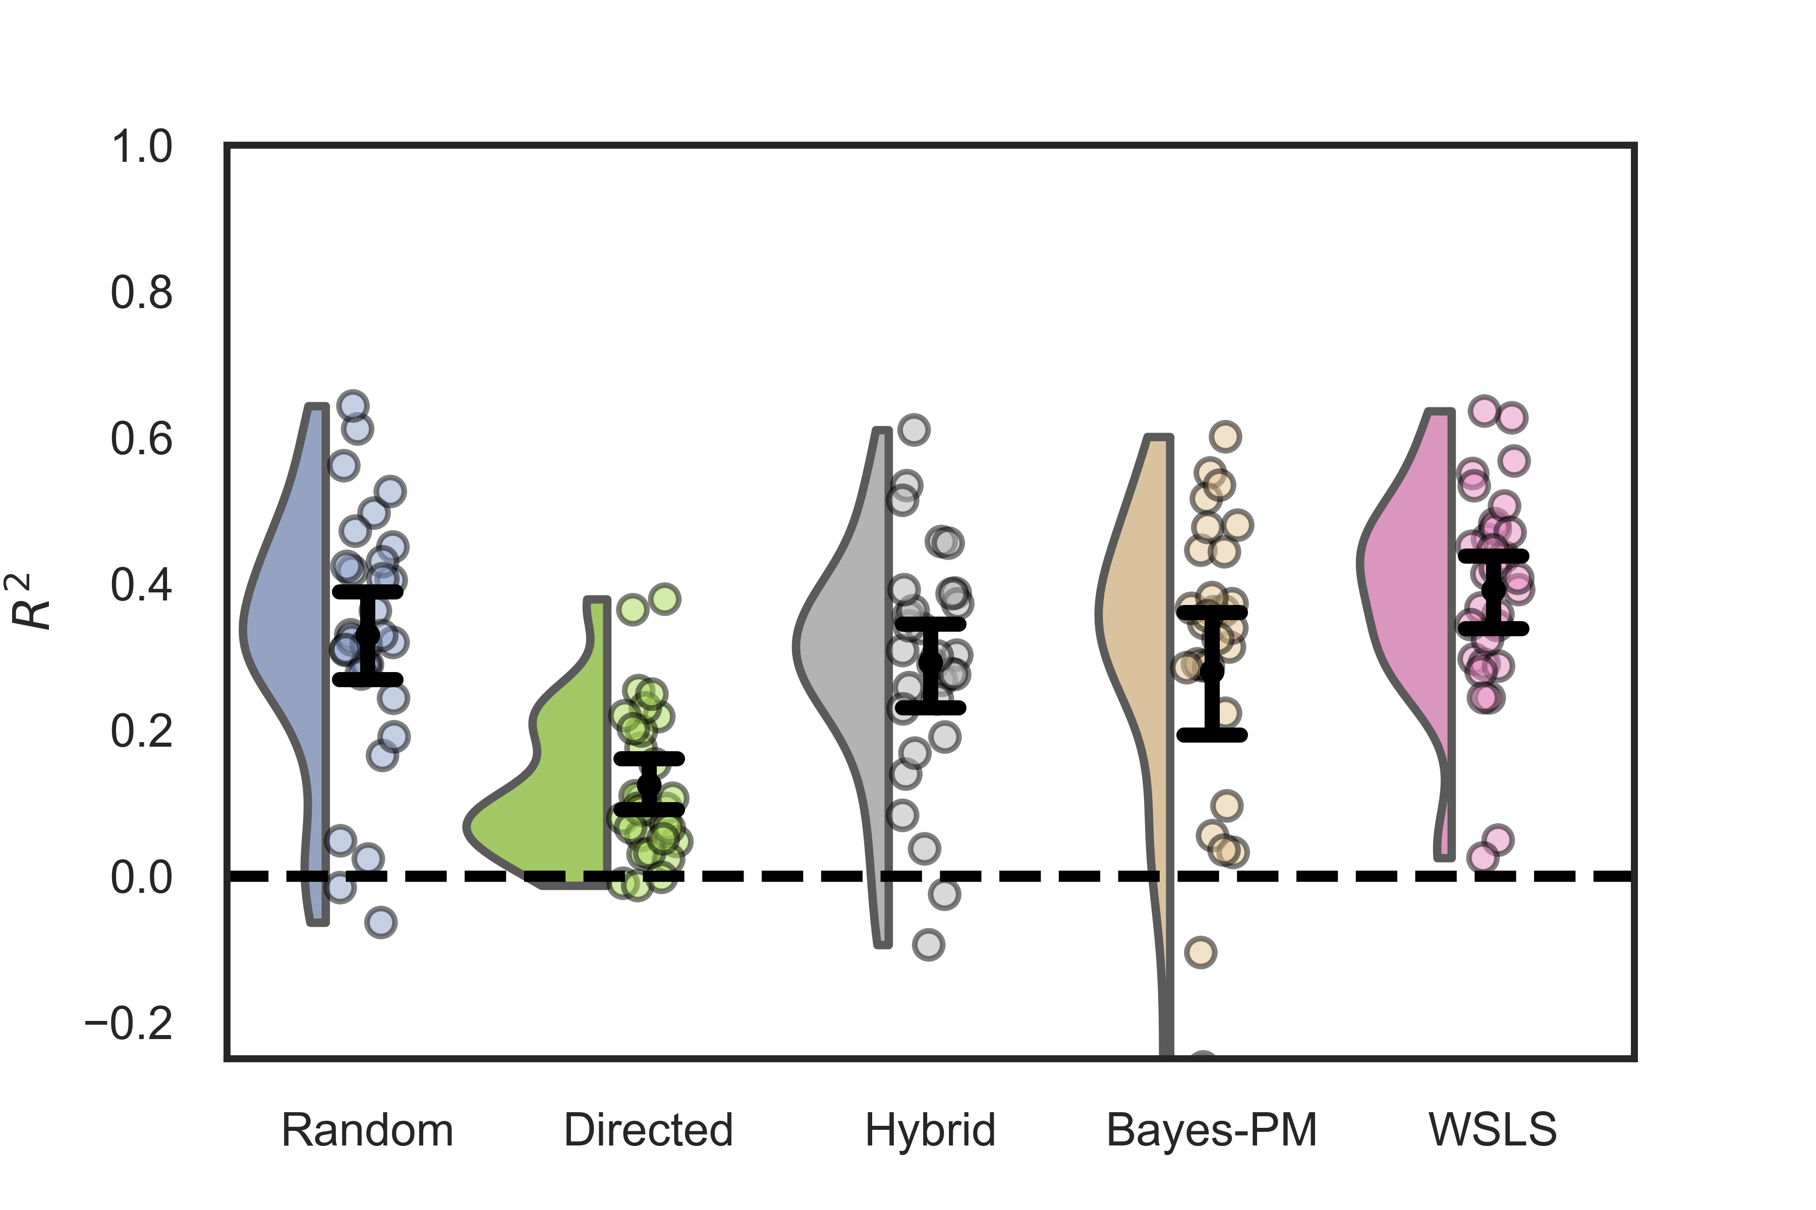
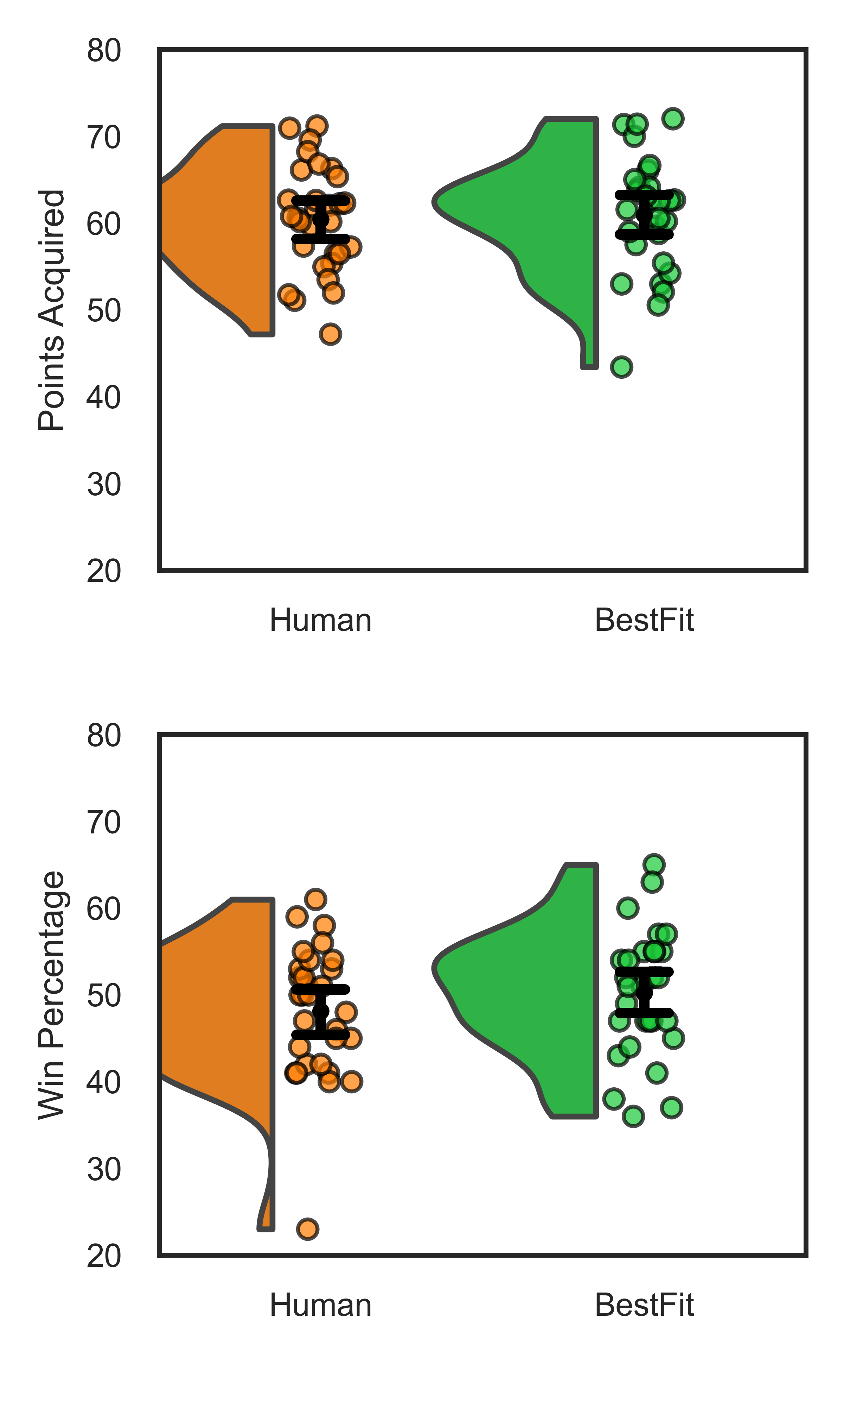
Results (Volatile)
4/30
5/30
20/30
1/30
n = 30
95% between subject CI
Ferguson et al., accepted

Slide 14
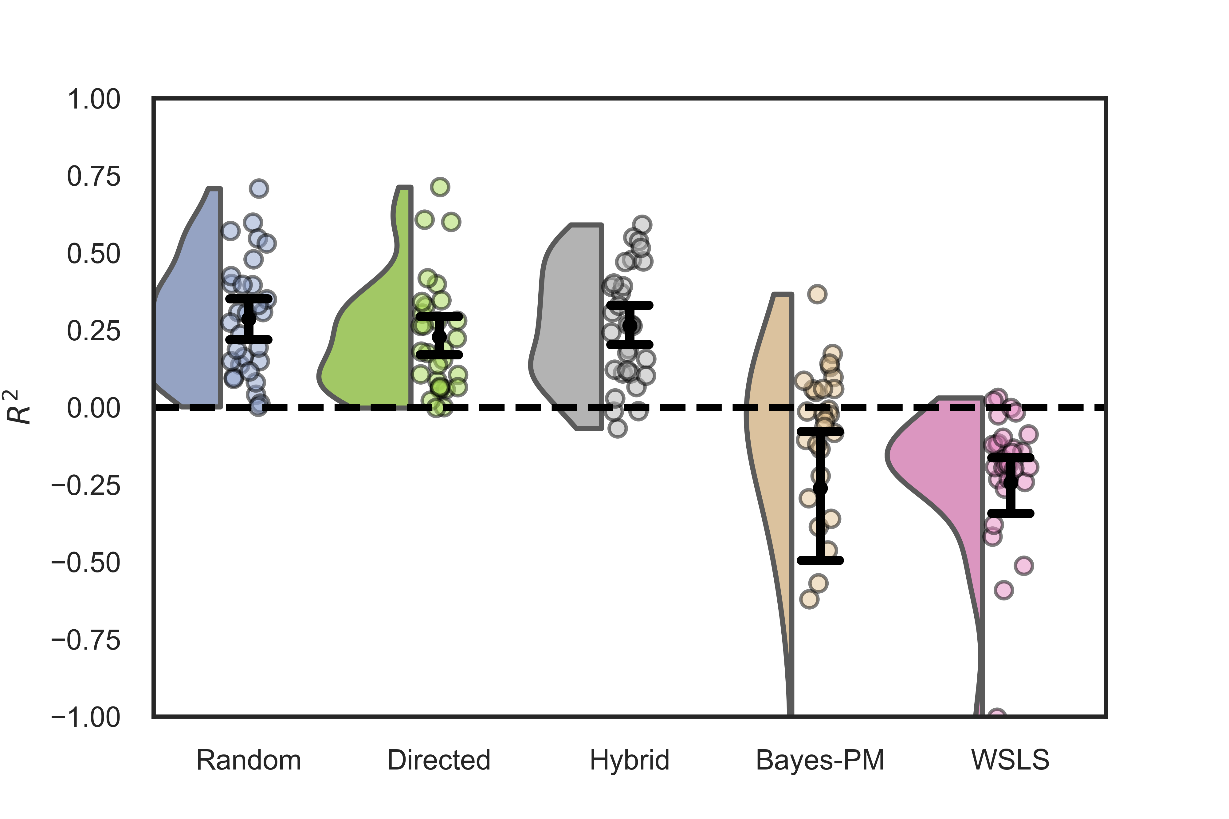
Results (Stable)
20/30
10/30
n = 30
95% between subject CI
Ferguson et al., accepted

Slide 15
Results
r(28) = .45*
r(28) = -.56**
r(28) = -.88***
n = 30
95% between subject CI
Ferguson et al., accepted

Slide 16
Interpretations - Strategies
Volatility shifts how people explore
Expected vs Unexpected uncertainty differences; acetylcholine /norepinephrine (Yu & Dayan, 2005)
Cognitive flexibility differences due to task (Kool & Botvinick, 2018)
Volatile
Stable
Ferguson et al., accepted

Slide 17
Interpretations – Exploration Rate
Exploration Rate was moderately correlated across tasks
Personality traits (i.e., risk taking, mind-wandering)
Hierarchical control of behaviour (i.e., dACC; Holroyd & Yeung, 2012)
Ferguson et al., accepted

Slide 18
Limitations
Features differed between the two tasks – what caused the strategy shift?
Factor | Bandit 1 | Bandit 2
Environment | Volatile | Stable
Options | 4 | 2
Feedback | Continuous (points) | Binary (Win, Loss)
Length | 400 trials | 6 blocks of 20 trials
52
+
Win
Ferguson et al., accepted

Slide 19
Future Work
Replication and extend - better control of confounds!
Collection of survey data and EEG data
Ferguson, Fyshe, White, in-prep

Slide 20


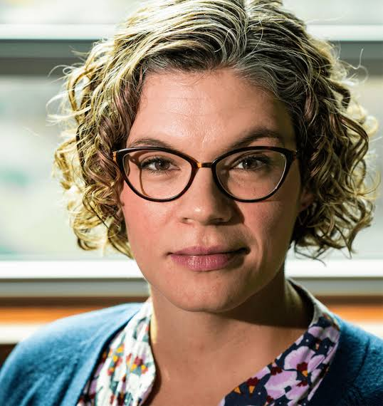
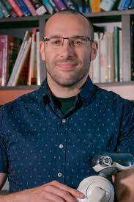


Funding and Collaborator Thanks!
Dr. Alona Fyshe
(UAlberta)
Dr. Adam White
(UAlberta)
Dr. Olav Krigolson
(UVic)

Slide 21
Parking Lot (additional figures)

Slide 22
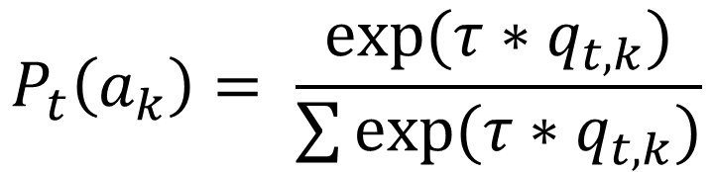
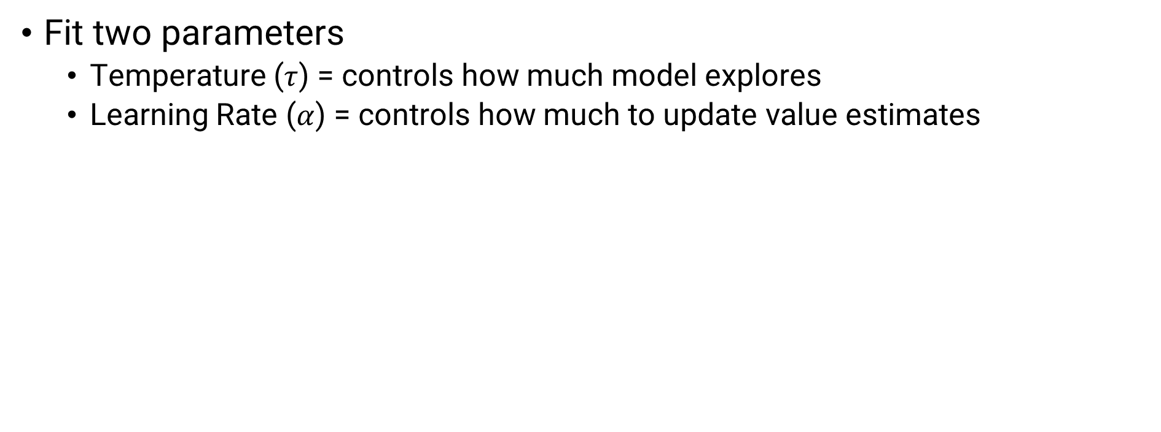
Parameter Fitting – Random Example
Fit two parameters
Temperature ($τ$) = controls how much model explores
Learning Rate ($α$) = controls how much to update value estimates
$$P_{t}\left(a_{k}\right)= \frac{exp⁡(τ∗q_{t,k})}{\sum{exp⁡(τ∗q_{t,k})}}$$
Choice Probability = take probability of individual arm, multiplied by temperature divided by the sum of all arms

Slide 23
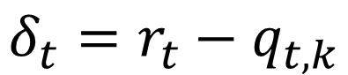
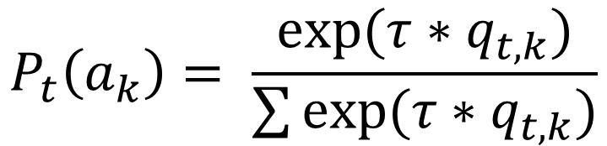
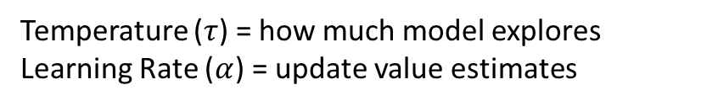
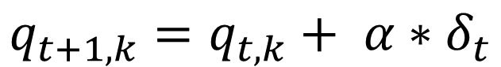
Parameter Fitting – Random Example
Equations
Plain English
Temperature ($τ$) = how much model explores
Learning Rate ($α$) = update value estimates
$$P_{t}\left(a_{k}\right)= \frac{exp⁡(τ∗q_{t,k})}{\sum{exp⁡(τ∗q_{t,k})}}$$
Choice Probability = take probability of individual arm, multiplied by temperature divided by the sum of all arms
$$δ_{t}=r_{t}−q_{t,k}$$
Delta = Difference between Reward and Reward Estimate
$$q_{t+1,k}=q_{t,k}+ α∗δ_{t}$$
Update Reward Estimate using Learning Rate and delta

Slide 24
Action Selection
Random
Version 1 – used an eGreedy action selection
Version 2 – used a Softmax action selection
Directed – Used an Upper Confidence bound action Selection
Hybrid – Combined Softmax with Upper Confidence Bound

Slide 25
Action Selection
Action Preference – Used a Gradient action selection
WSLS – Heuristic to stay following wins, switch following loses
Bayes-PM – Thompson Sampling action selection

Slide 26
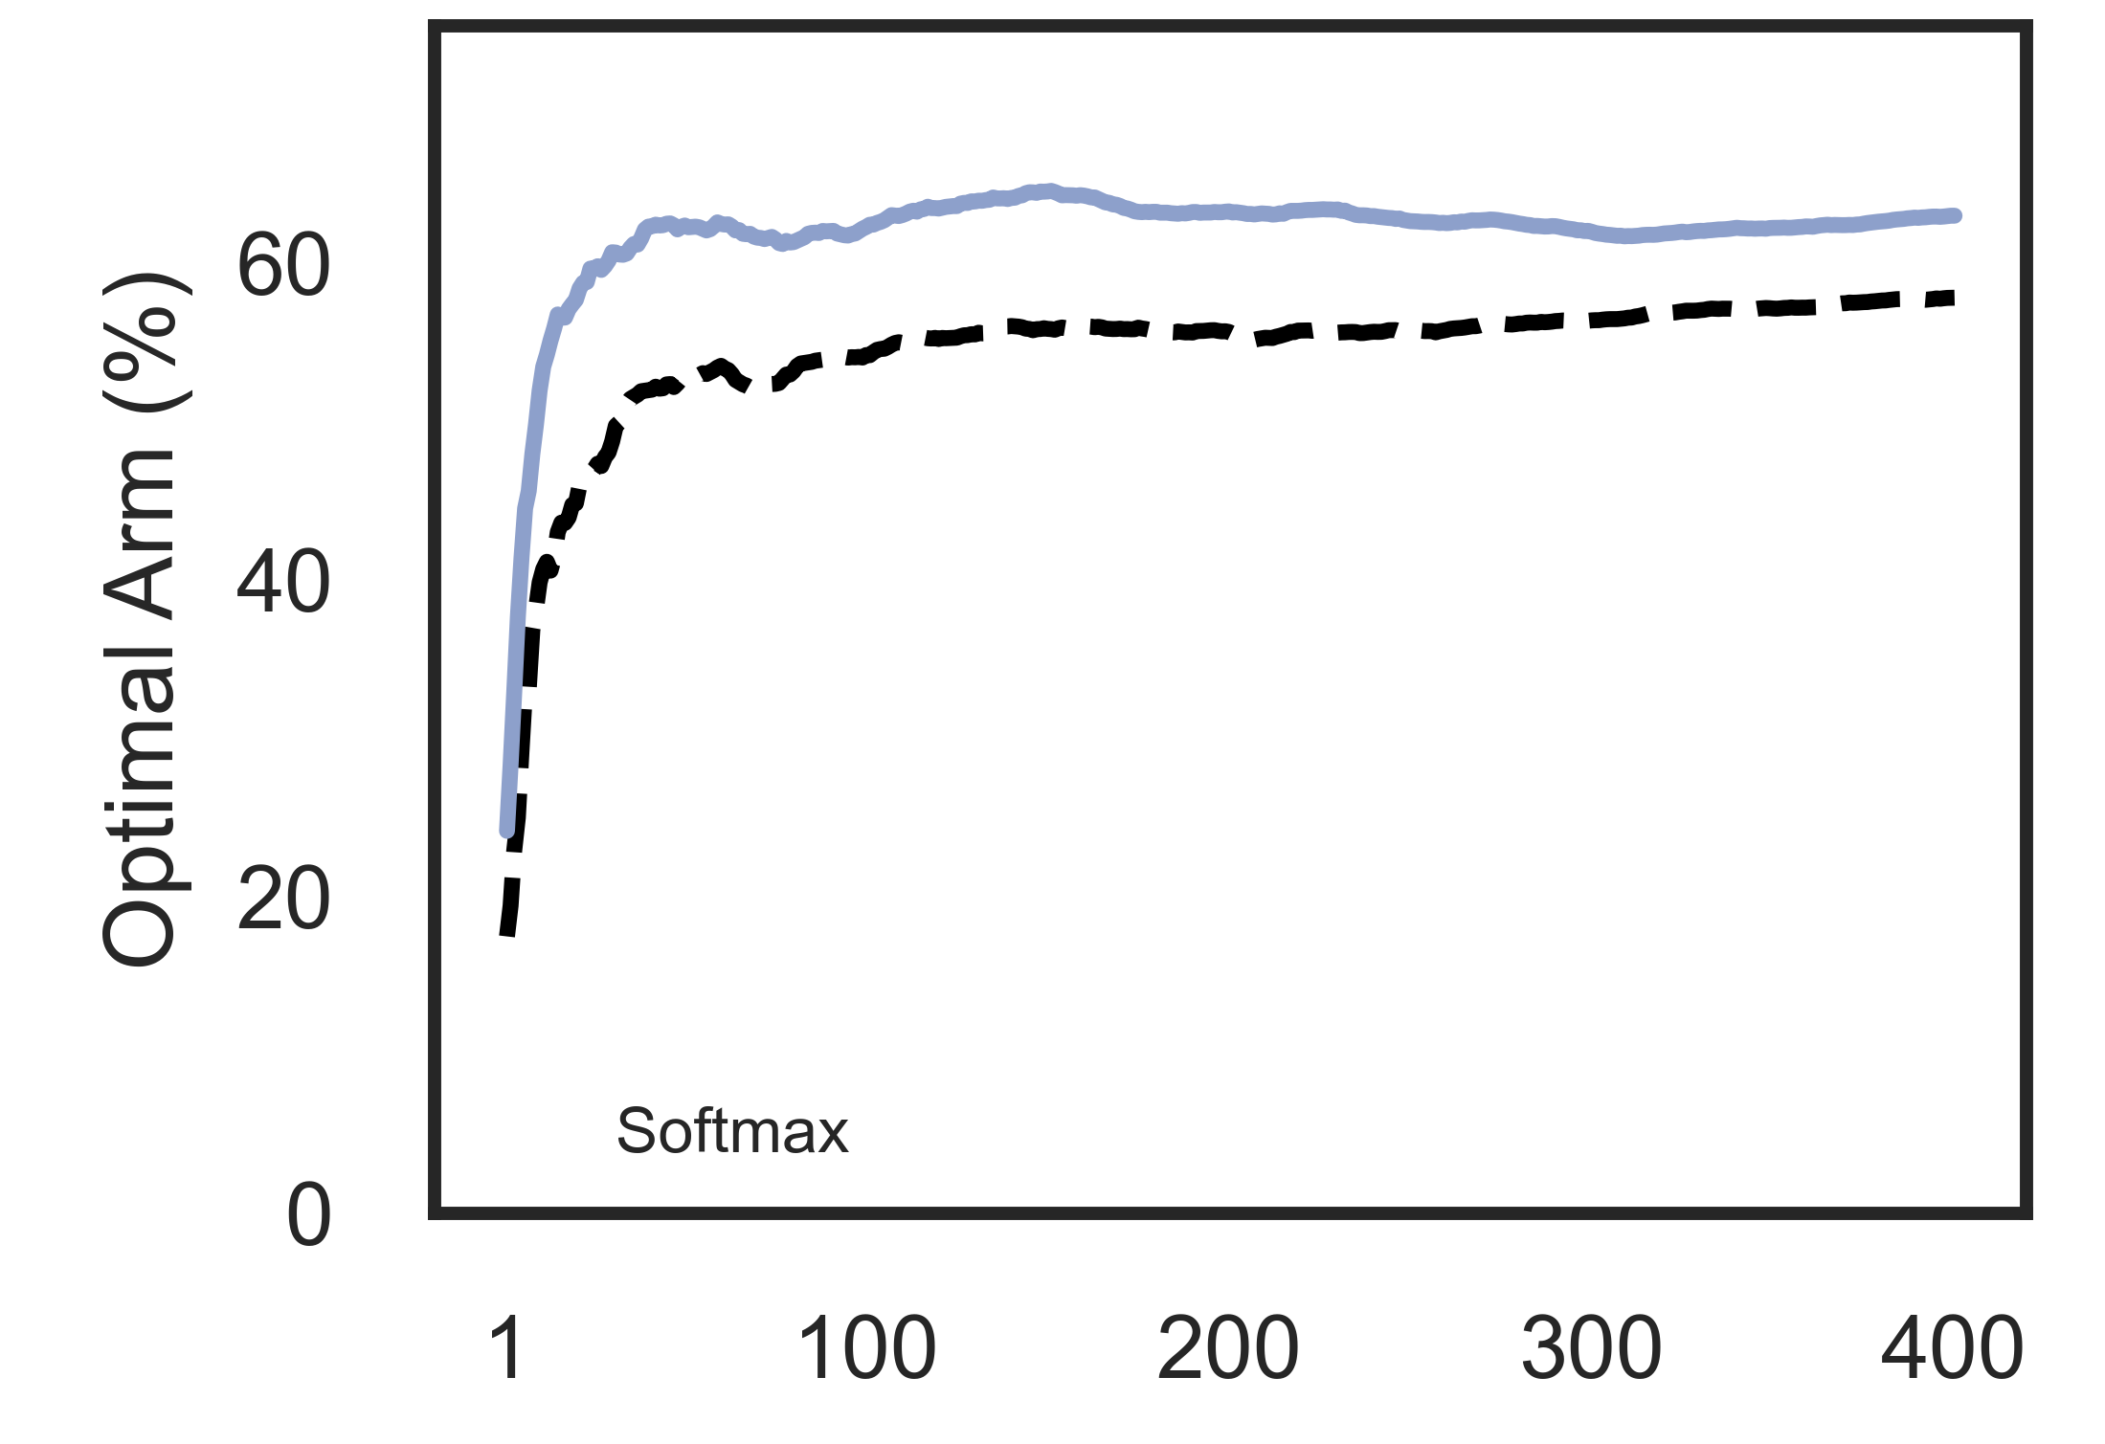
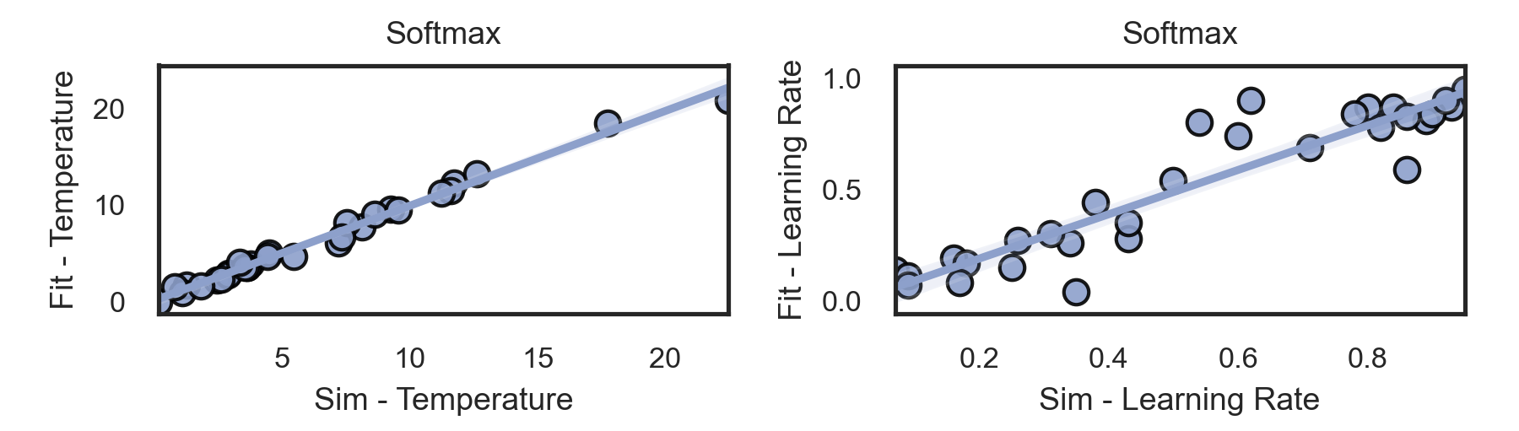
Model Validation
All models could have their parameters recovered effectively
All models could replicate behaviour in a test-bed
Random
Random
Random

Slide 27
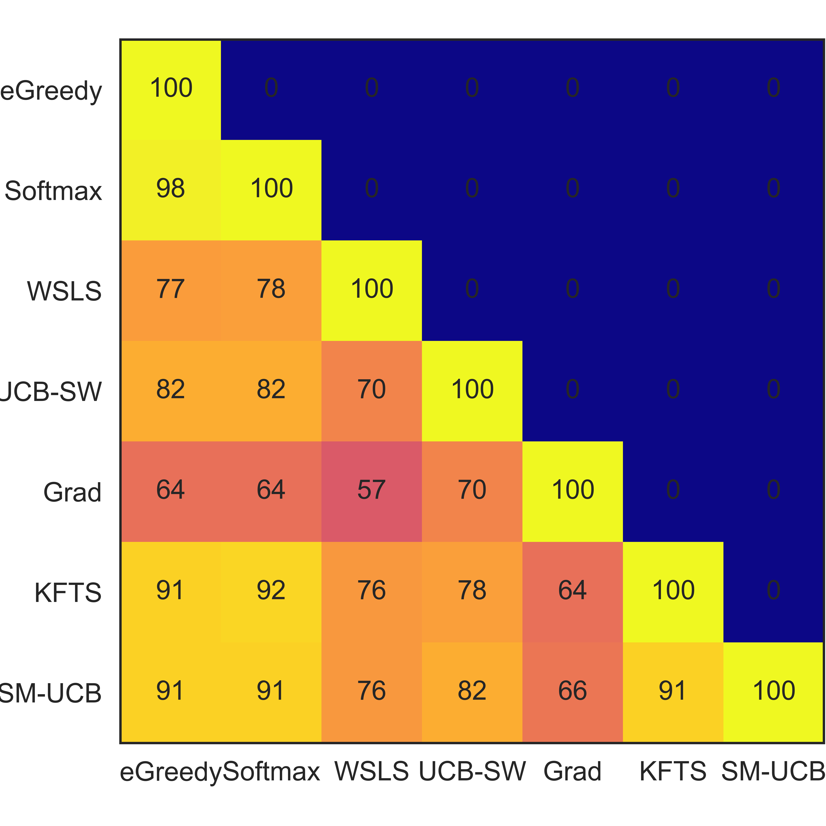
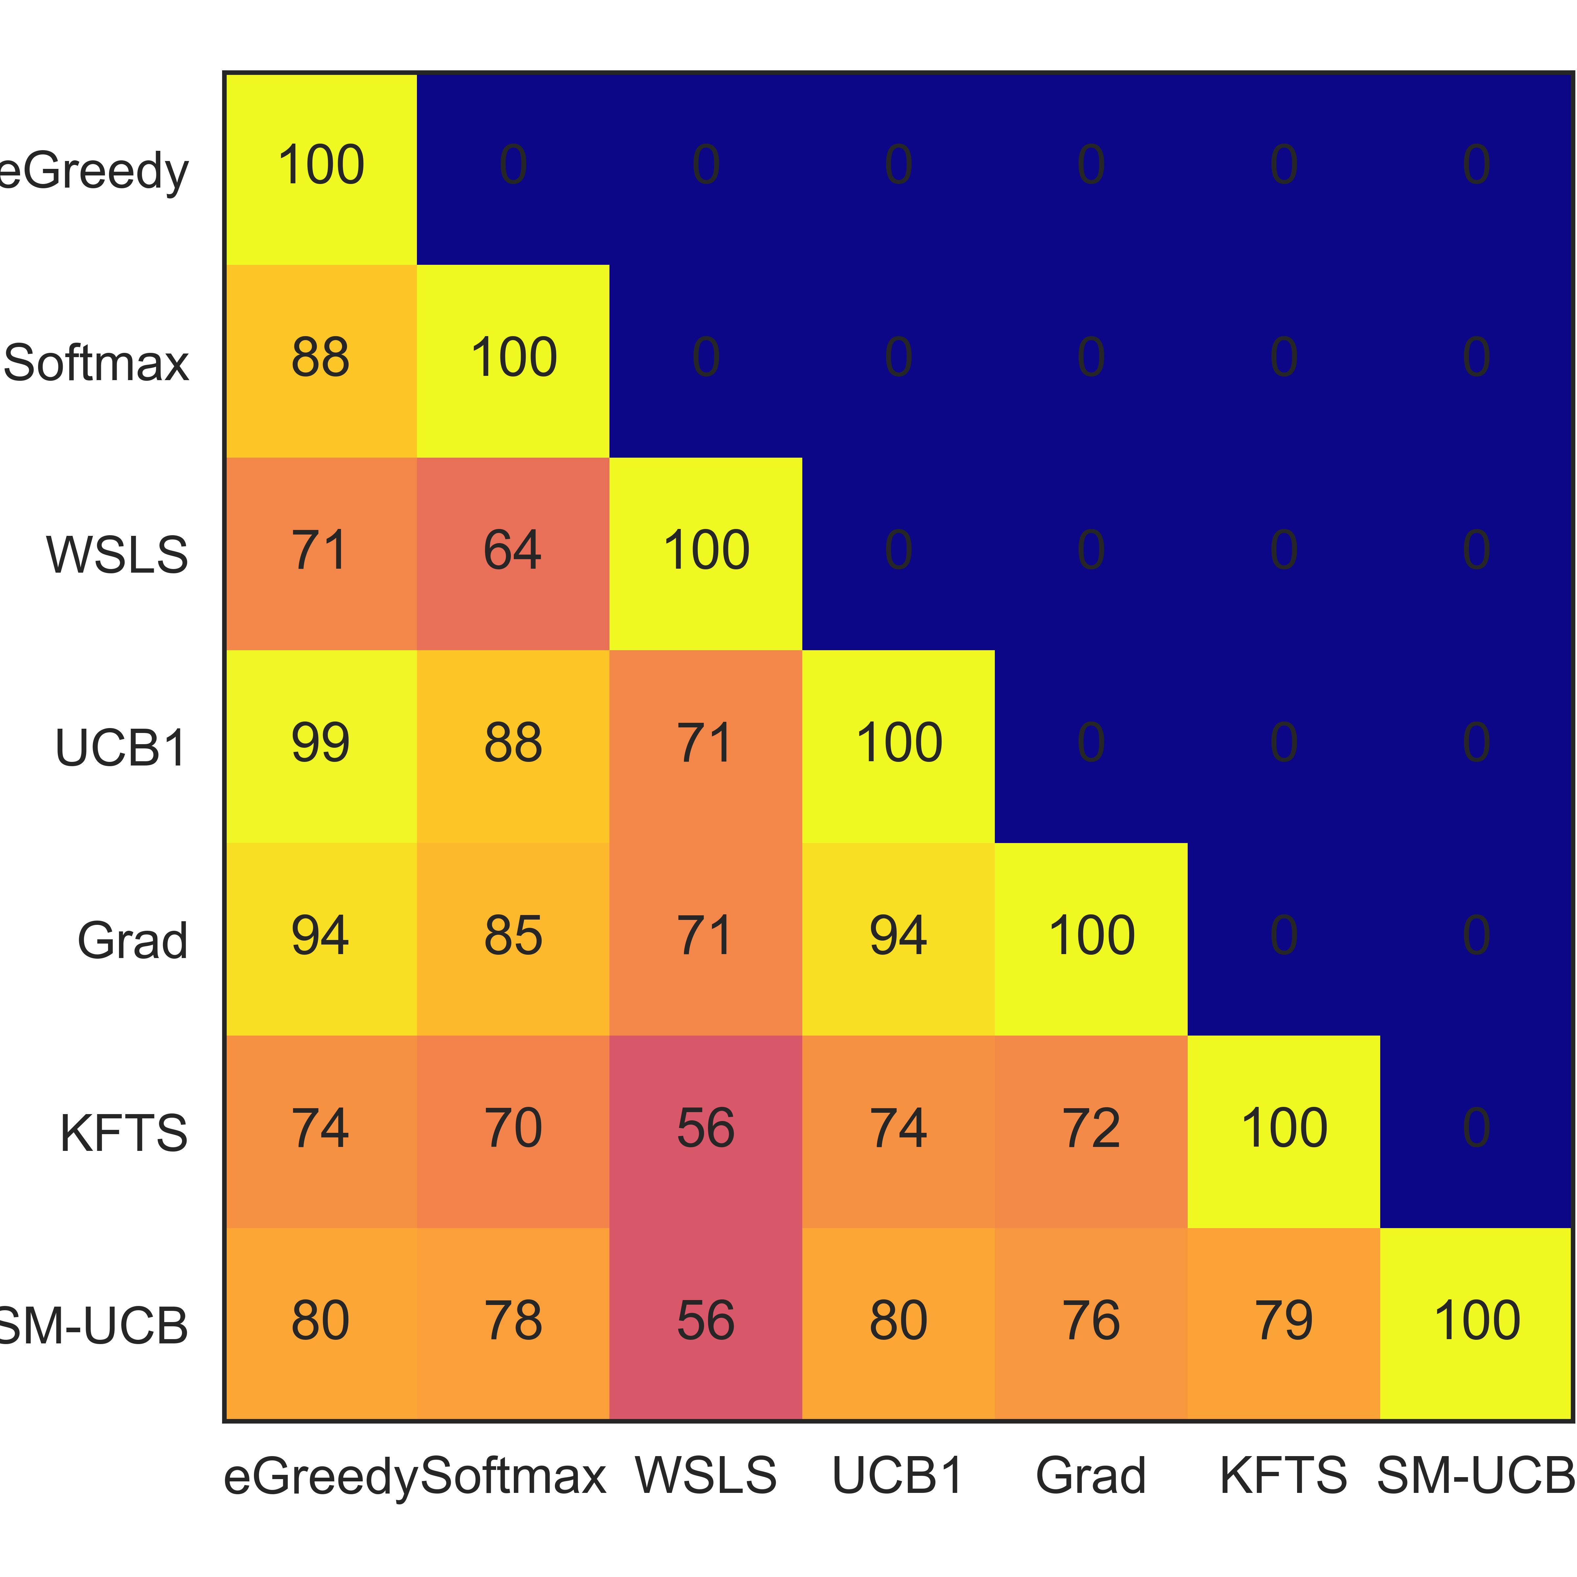
Exploration Overlap
Volatile
Stable
Random - eGreedy
Random - eGreedy
Random - Softmax
Random - Softmax
WSLS
Directed
Directed
WSLS
Action Preference
Action Preference
Bayes - PM
Bayes - PM
Hybrid
Hybrid
Random eGreedy
Random Softmax
Action Preference
Random eGreedy
Random Softmax
WSLS
Directed
Action Preference
Bayes - PM
WSLS
Directed
Bayes - PM
Hybrid
Hybrid

Slide 28
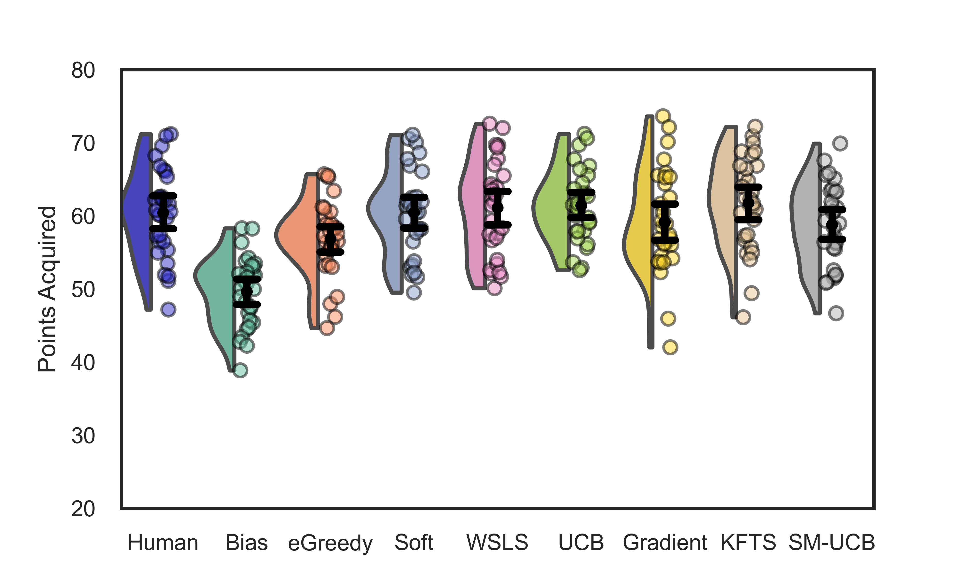
Mean Performance (Non-Stationary)
Human
Baseline
Random - eGreedy
Random - Softmax
WSLS
Directed
Action Preference
Bayes - PM
Hybrid

Slide 29
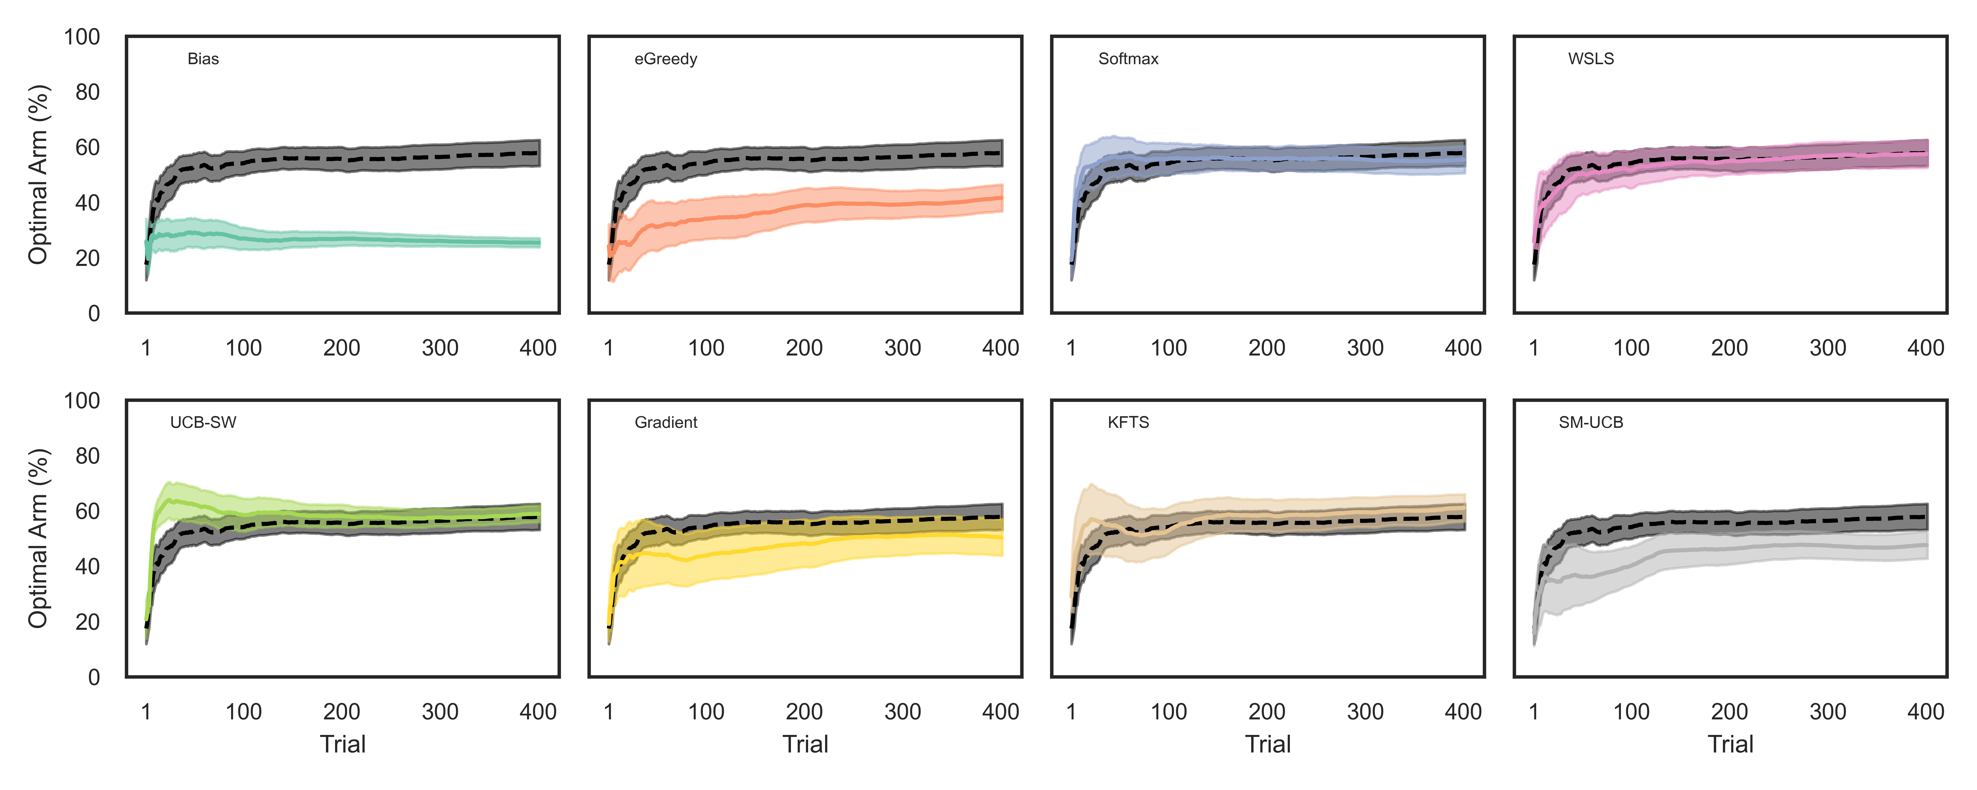
Trial by Trial (Non-Stationary)
Baseline
Random - eGreedy
Random - Softmax
WSLS
Directed
Action Preference
Bayes - PM
Hybrid

Slide 30
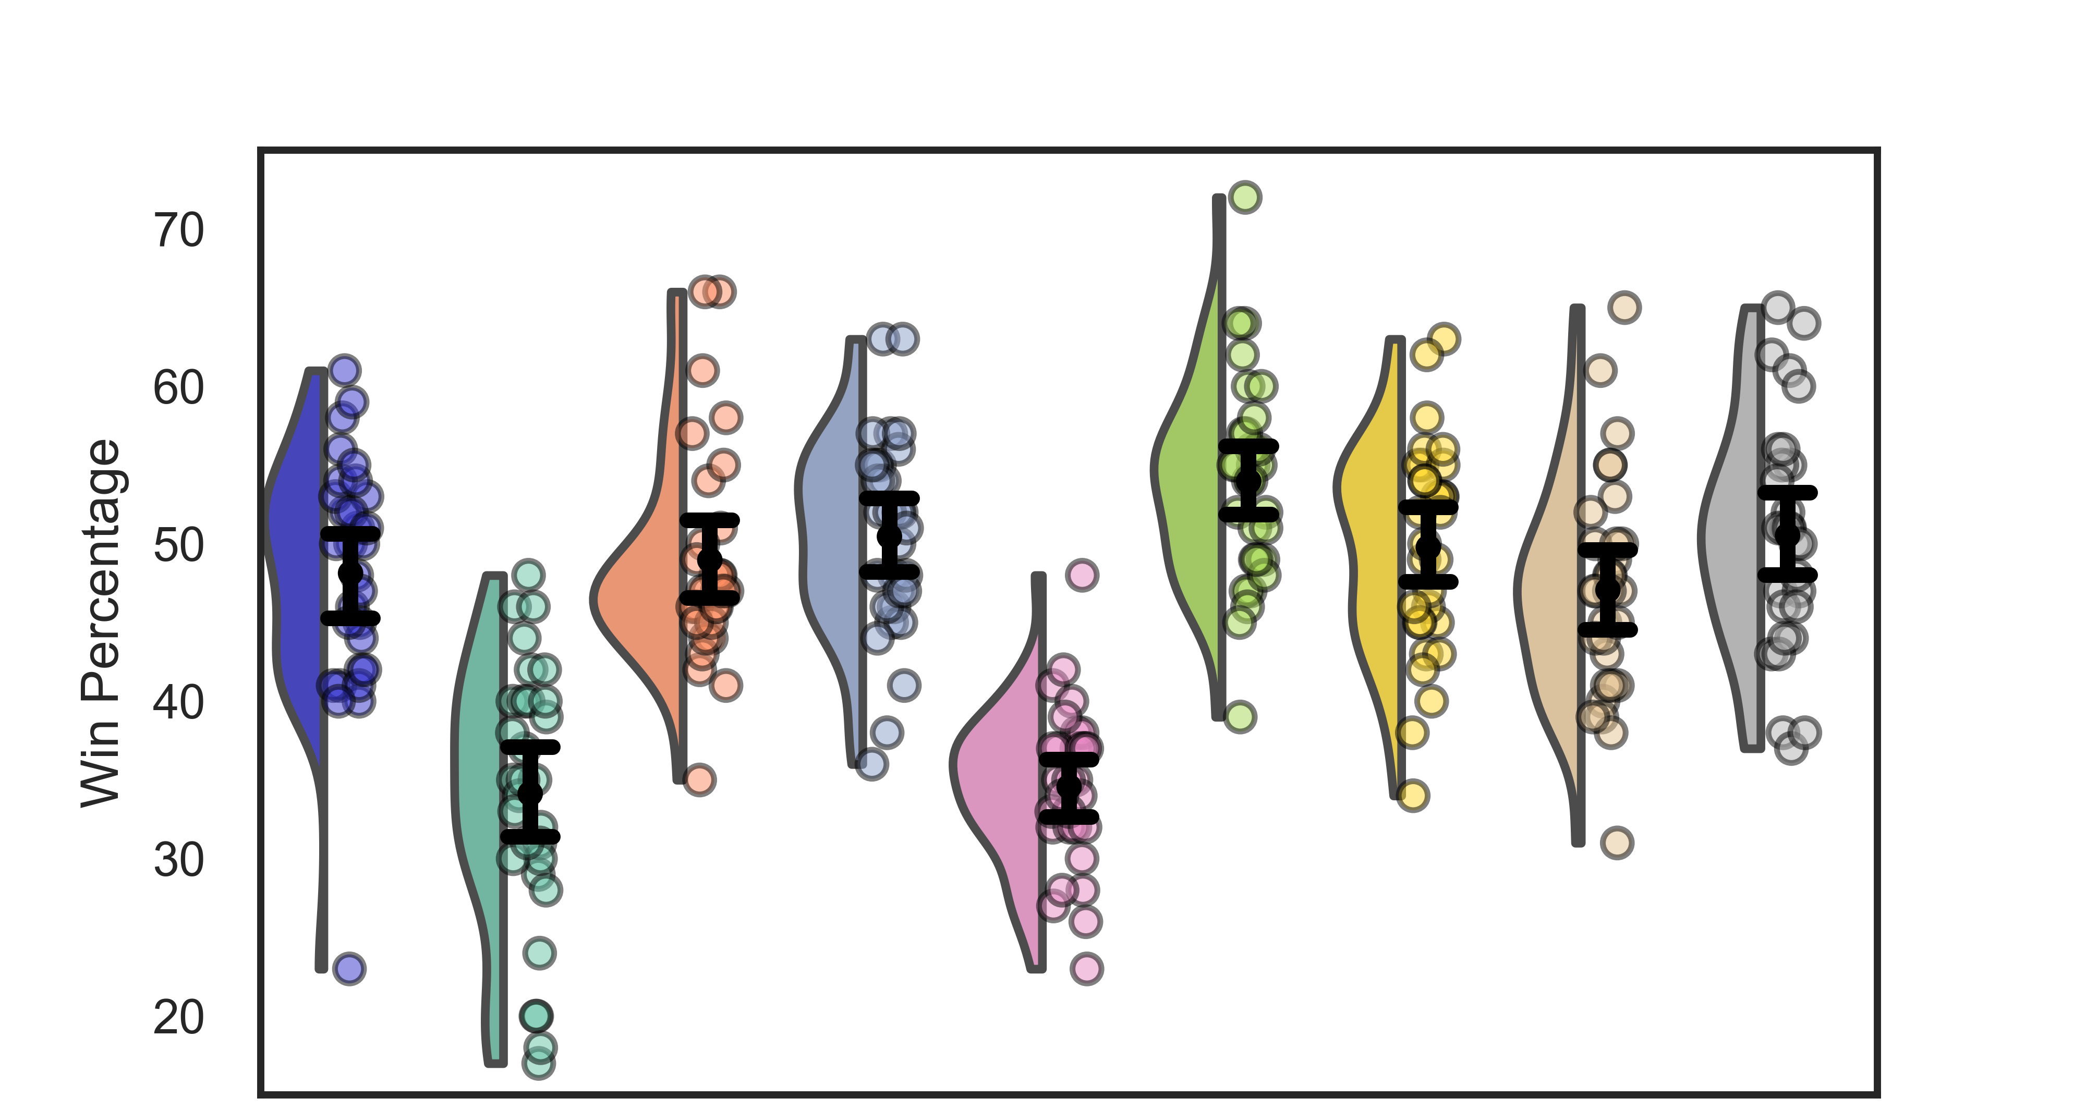
Mean Performance (Stationary)
Human
Baseline
Random - eGreedy
Random - Softmax
WSLS
Directed
Action Preference
Bayes - PM
Hybrid

Slide 31
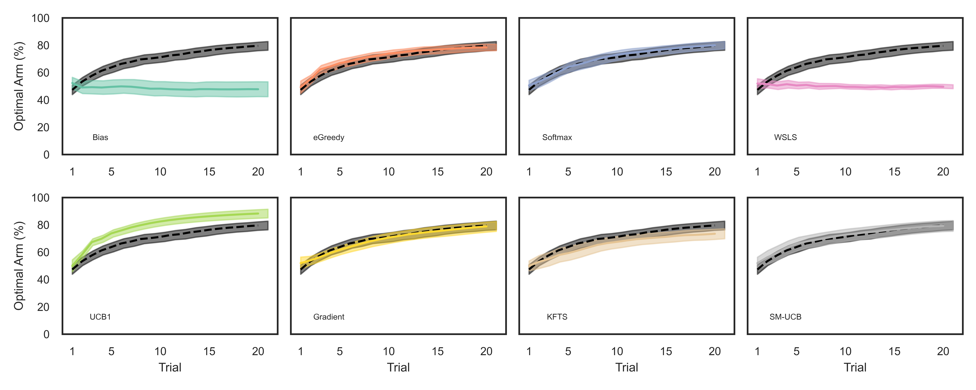
Trial by Trial (Stationary)
Random - eGreedy
Random - Softmax
Baseline
WSLS
Action Preference
Bayes - PM
Directed
Hybrid

